Slide 1
Mendelian Genetics
Introduction to Biology

Slide 2
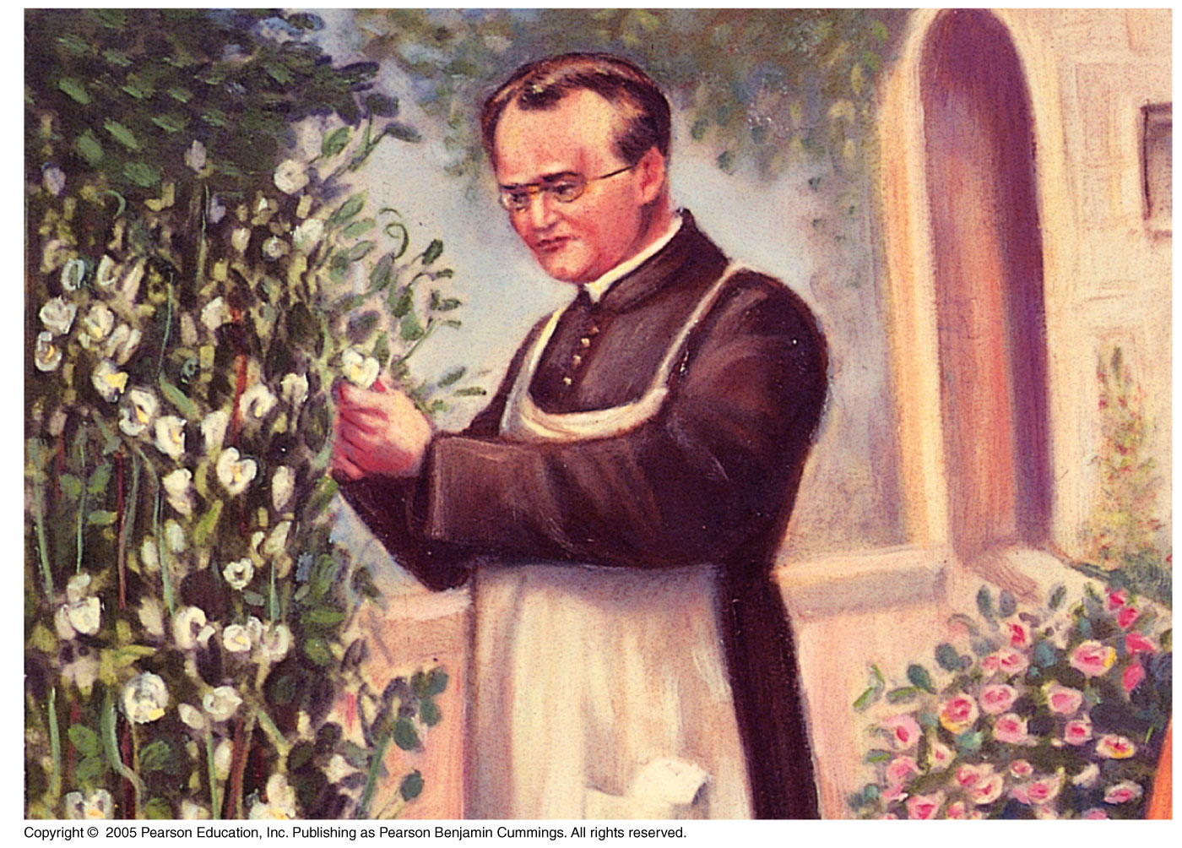

Slide 3
Gregor Mendel
Gregor Mendel discovered the basic principles of heredity by breeding garden peas in carefully planned experiments

Slide 4
Mendel’s Experimental, Quantitative Approach
Advantages of pea plants for genetic study:
There are many varieties with distinct heritable features. (flower color, seed color, etc)
Each pea plant has sperm-producing organs (stamens) and egg-producing organs (carpels)
Cross-pollination can be achieved by dusting one plant with pollen from another

Slide 5
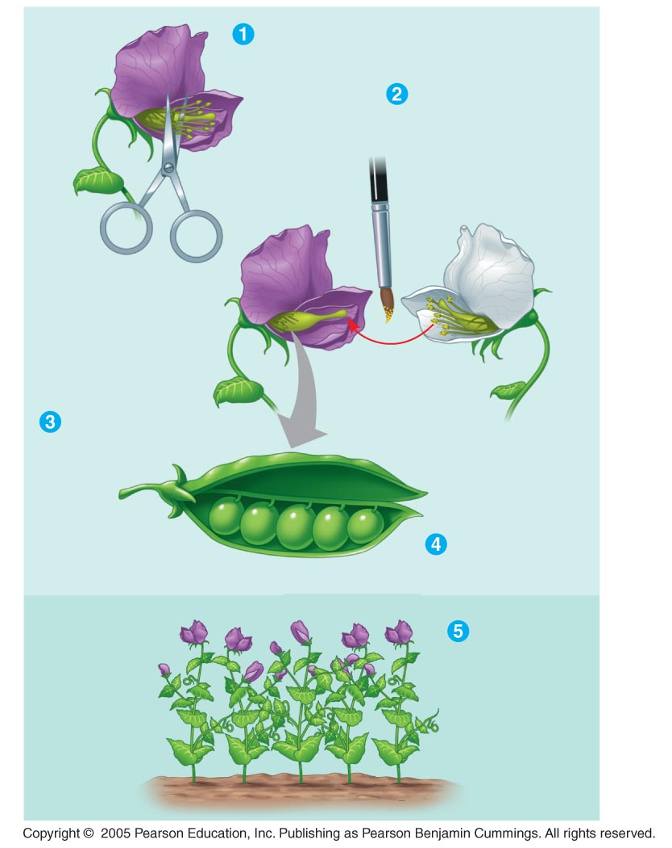
LE 14-2
Removed stamens
from purple flower
Transferred sperm-
bearing pollen from
stamens of white
flower to egg-
bearing carpel of
purple flower
Parental
generation
(P)
Carpel
Stamens
Pollinated carpel
matured into pod
Planted seeds
from pod
Examined
offspring:
all purple
flowers
First
generation
offspring
(F₁)

Slide 6
Mendel chose to track only those characters that varied in an “either-or” manner.
Two varieties of a trait, such as wrinkled or smooth seeds.
He also used varieties that were “true-breeding” (plants that produce offspring of the same variety when they self-pollinate)
For example, a plant with white flowers that only produces white flowered offspring.

Slide 7
In a typical experiment, Mendel mated two contrasting, true-breeding varieties, a process called hybridization.
The true-breeding parents are the P generation.
The hybrid offspring of the P generation are called the F₁ generation.
When F₁ individuals self-pollinate, the F₂ generation is produced.

Slide 8
The Law of Segregation
When Mendel crossed contrasting, true-breeding white and purple flowered pea plants, all of the F₁ hybrids were purple
When Mendel crossed the F₁ hybrids, about 75% of the generation had purple flowers, 25% had white flowers.
Why did the white flower color disappear from the first generation, then re-appear during the second?

Slide 9
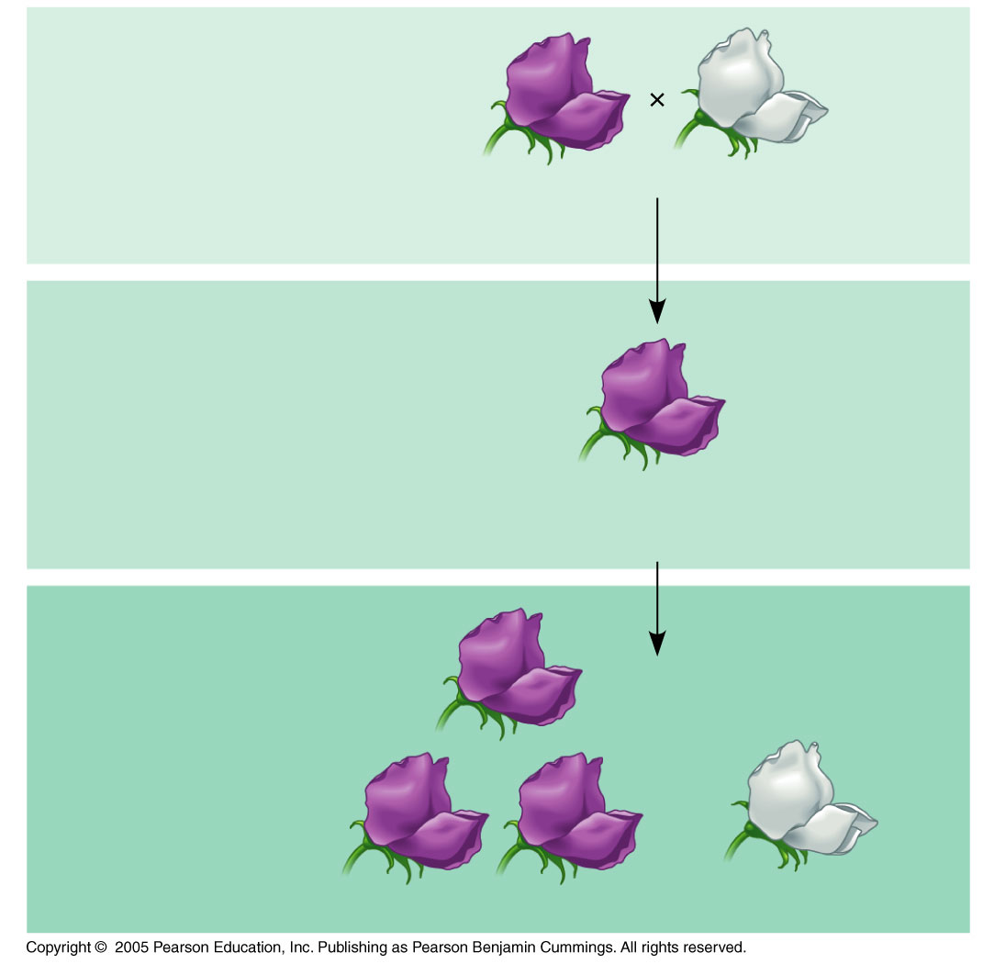
LE 14-3
P Generation
(true-breeding
parents)
Purple
flowers
White
flowers
F₁ Generation
(hybrids)
All plants had
purple flowers
F₂ Generation

Slide 10
Mendel called the purple flower color a dominant trait and white flower color a recessive trait.
Mendel observed the same pattern of inheritance in six other pea plant characters, each represented by two traits
These traits were all controlled by individual genes, which are segments of DNA within different chromosomes.

Slide 11
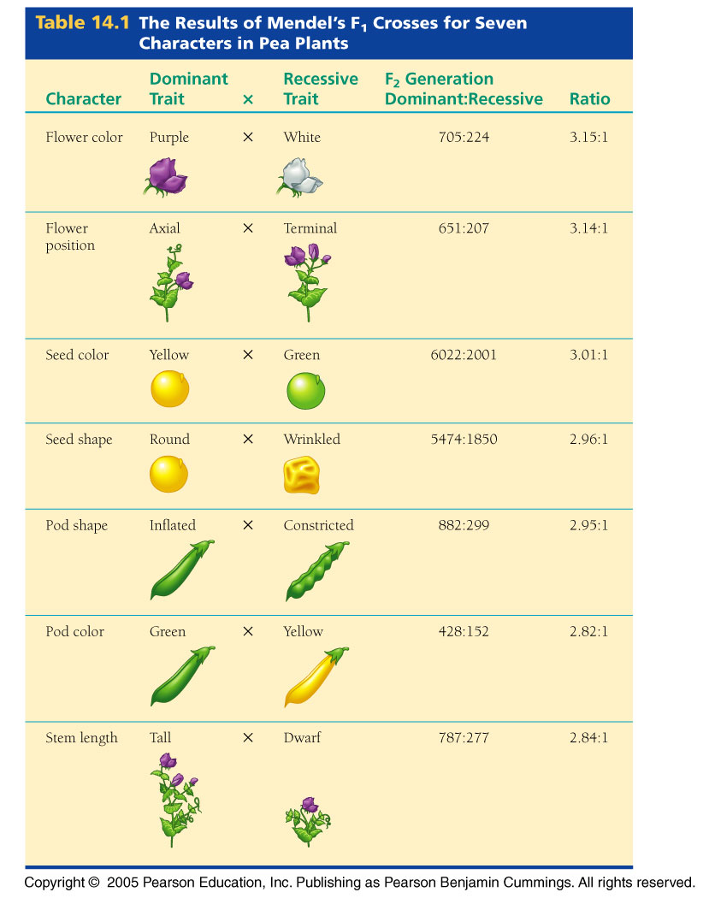

Slide 12
Mendel’s Model
Mendel developed a hypothesis to explain the 3:1 inheritance pattern he observed in F₂ offspring
Four related concepts make up this model
These concepts can be related to what we now know about genes and chromosomes

Slide 13
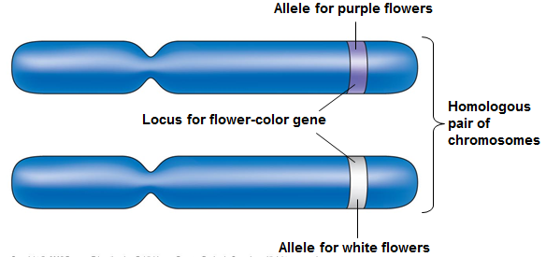
Mendel’s First Concept is that alternative versions of genes account for variations in inherited characteristics.
For example, the gene for flower color in pea plants exists in two versions, one for purple flowers and the other for white flowers
These alternative versions of a gene are now called alleles
Each gene resides at a specific locus on a specific chromosome

Slide 14
Mendel’s second concept is that for each characteristic, an organism inherits two alleles: one from each parent.
Mendel made this deduction without knowing about the role of chromosomes
The two alleles can be identical, such as with a true-breeding pea plant.
The two alleles can also differ, such as in a hybrid.

Slide 15
Mendel’s third concept is that if the two alleles at a locus differ, the dominant allele will be expressed, the recessive allele will be hidden.

Slide 16
Mendel’s fourth concept states that an egg or a sperm gets only one of the two alleles that are present in the somatic cells of an organism.
This is now called independent assortment.
This is caused by the independent assortment of homologous chromosomes to different daughter cells during meiosis.

Slide 17
The possible combinations of sperm and egg can be shown using a Punnett square, a diagram for predicting the results of a genetic cross between individuals of known genetic makeup
Each gene is represented by a pair of letters.
A capital letter represents a dominant allele
A lowercase letter represents a recessive allele.
Example:
Upper case P represents a purple allele
p represents a white allele

Slide 18
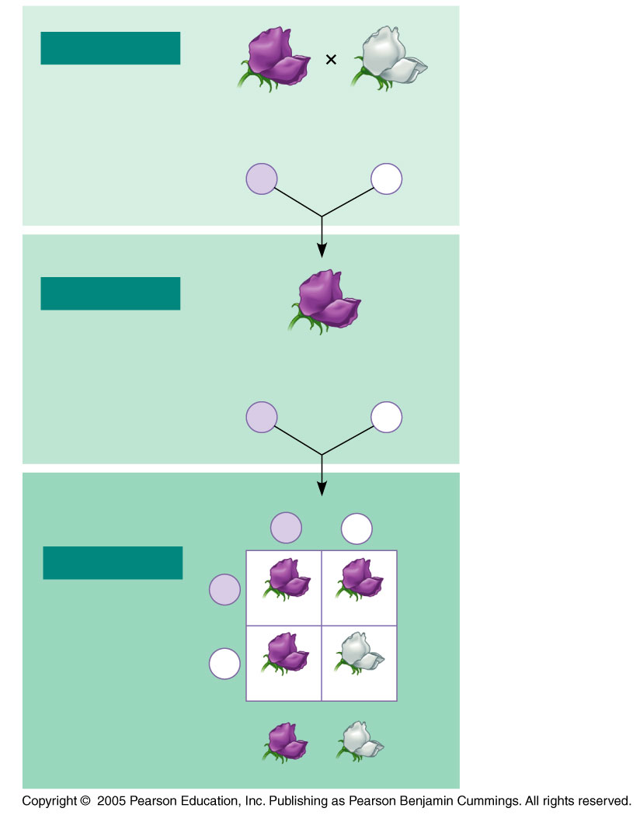
LE 14-5_2
P Generation
Appearance:
Purple
flowers
PP
White
flowers
pp
Genetic makeup:
Gametes
P
p
F₁ Generation
Appearance:
Genetic makeup:
Purple flowers
Pp
Gametes:
1
2
P
1
2
p
F₁ sperm
P
p
F₂ Generation
P
F₁ eggs
PP
Pp
p
Pp
pp
3
: 1

Slide 19
Useful Genetic Vocabulary
An organism with two identical alleles for a character is said to be homozygous for the gene controlling that character.
An organism that has two different alleles for a gene is said to be heterozygous for the gene controlling that character.

Slide 20
Because of the different effects of dominant and recessive alleles, different allele combinations can produce the same characteristics.
PP = Purple
Pp = Purple
pp = white
Phenotype is the organism’s physical appearance, genotype is the organism’s alleles.

Slide 21
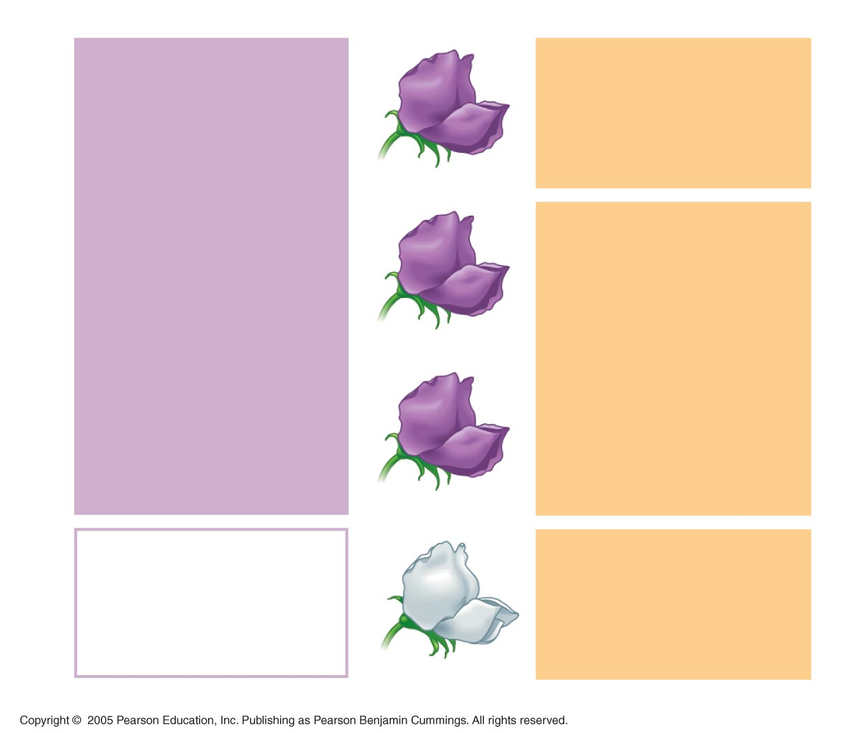
LE 14-6
Phenotype
Genotype
Purple
PP
(homozygous
1
3
Pp
(heterozygous
Purple
2
Purple
Pp
(heterozygous
1
White
pp
(homozygous
1
Ratio 3:1
Ratio 1:2:1

Slide 22
The Testcross
How can we tell the genotype of an individual with the dominant phenotype?
The individual could be either homozygous dominant or heterozygous.
The answer is to carry out a testcross: breeding the mystery individual with a homozygous recessive individual
If any offspring display the recessive phenotype, the mystery parent must be heterozygous.

Slide 23
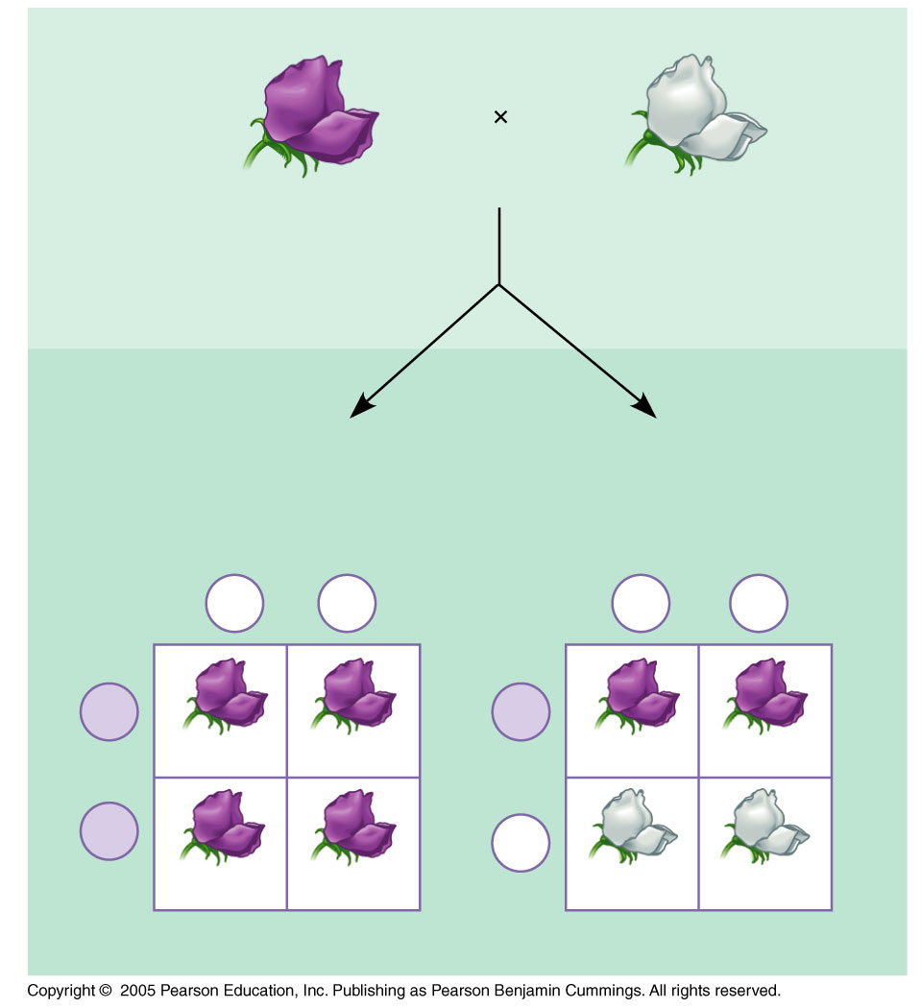
LE 14-7
Dominant phenotype,
unknown genotype:
PP or Pp?
Recessive phenotype,
known genotype:
pp
If PP,
then all offspring
purple:
If Pp,
then ¹ ₂ offspring purple
and ¹ ₂ offspring white:
p
p
p
p
P
P
Pp
Pp
Pp
Pp
P
P
Pp
Pp
pp
pp

Slide 24
The Law of Independent Assortment
The Law of Segregation states that each individual will randomly pass along only one of its two alleles for a trait to its offspring.
A pea plant that is Pp has a 50% chance of passing the P allele, and a 50% change of passing the p allele.
Mendel derived the law of segregation by breeding pea plants that were hybrids of one characteristic.
These are called monohybrid crosses.

Slide 25
Mendel then took two parents that were true-breeding for two characteristics and crossed them to create offspring that were heterozygous hybrids for each trait.
Example: PpWw = Purple flower, wrinkled seeds
He then performed a dihybrid cross, where two hybrids were bred together.

Slide 26
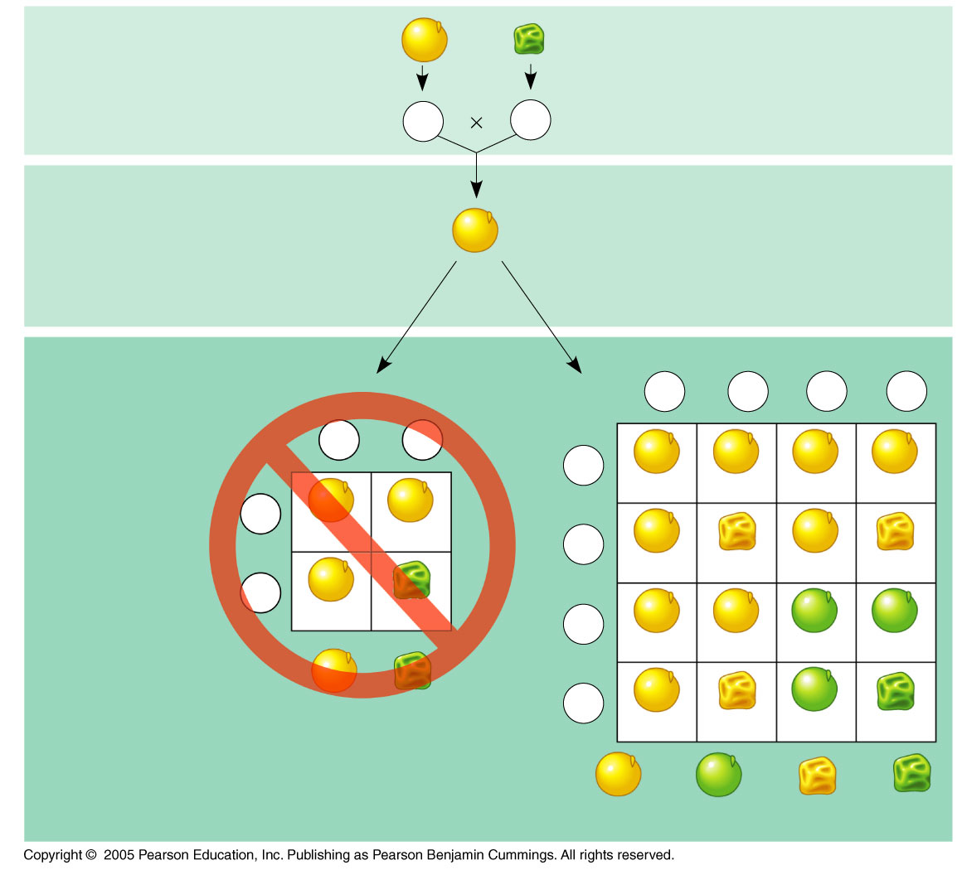
LE 14-8
P Generation
YYRR
yyrr
Gametes
YR
yr
F₁ Generation
YyRr
Hypothesis of
dependent
assortment
Hypothesis of
independent
assortment
Sperm
Sperm
1
4
YR
1
4
Yr
1
4
yR
1
4
yr
1
YR
1
yr
Eggs
2
2
1
YR
Eggs
4
YYRR
YYRr
YyRR
YyRr
F₂ Generation
(predicted
offspring)
1
2
YR
YYRR
YyRr
1
4
Yr
YYRr
YYrr
YyRr
Yyrr
1
2
yr
YyRr
yyrr
1
4
yR
YyRR
YyRr
yyRR
yyRr
3
4
1
4
Phenotypic ratio 3:1
1
4
yr
YyRr
Yyrr
yyRr
yyrr
9
16
3
16
3
16
3
16
Phenotypic ratio 9:3:3:1

Slide 27
Using a dihybrid cross, Mendel developed the law of independent assortment
This law states that each pair of alleles segregates independently of other pairs of alleles during meiosis.
Strictly speaking, this law applies only to genes on different, nonhomologous chromosomes.
Genes located near each other on the same chromosome tend to be inherited together

Slide 28
Probability
Mendel’s laws of segregation and independent assortment reflect the rules of probability
When tossing a coin, the outcome of one toss has no impact on the outcome of the next toss
Odds of getting tails on first coin flip:
½ or 50%
Odds of getting tails on fifth coin flip after getting tails 4 times in a row:
½ or 50%
The random assort alleles of each gene follow the same rules.

Slide 29
Multiplication Rule
Multiplication Rule: The odds of two events occurring in a row can be calculated by multiplying their probabilities together.
Odds of hitting tails twice in a row = ½ x ½ = ¼

Slide 30
Addition Rule
Addition Rule: The odds of getting a combination of events to occur can be calculated by adding their probabilities together.
If you flip two coins, your probabilities are…
¼ Heads + heads ¼ Heads + tails ¼ Tails + heads ¼ Tails + tails | = ½ or 50% odds of getting a combination of heads and tails

Slide 31
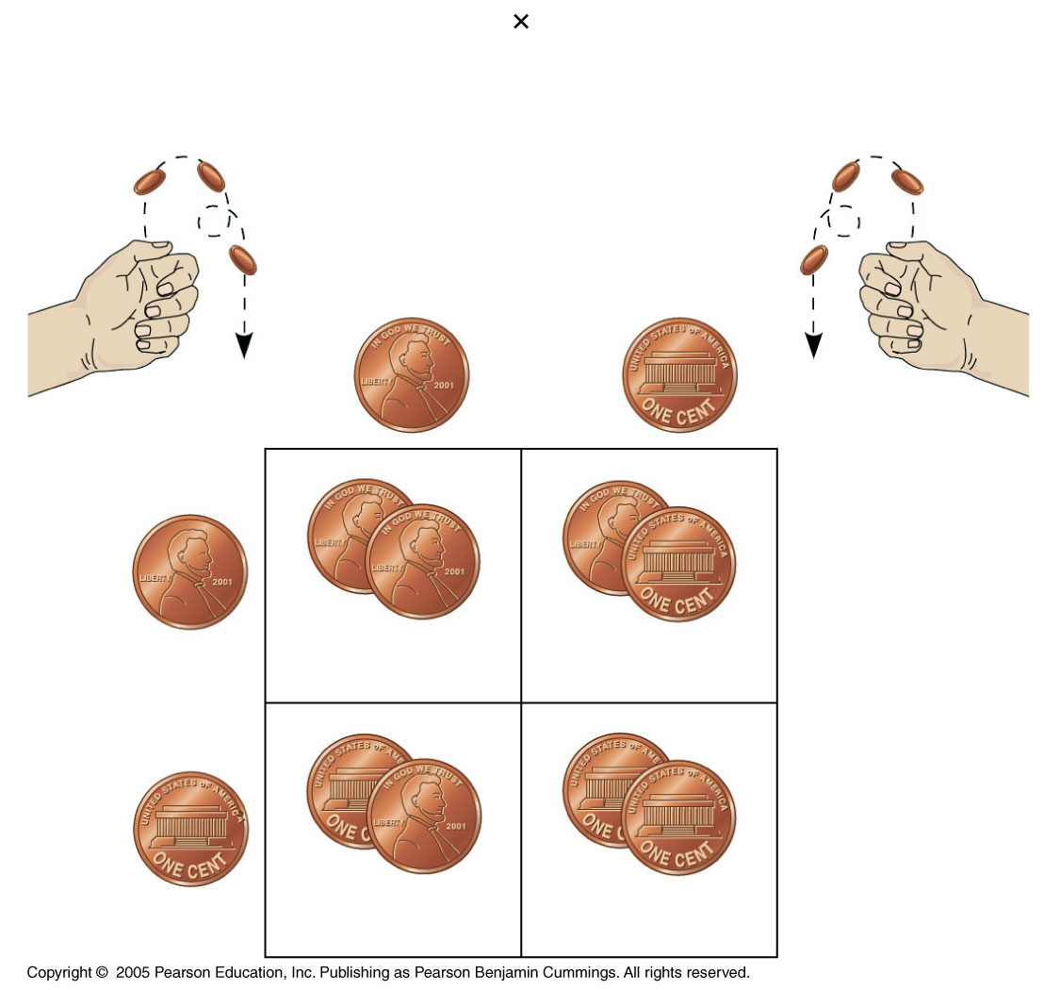
LE 14-9
Rr
Rr
Segregation of
alleles into eggs
Segregation of
alleles into sperm
Sperm
1
2
R
1
2
r
R
R
1
R
R
r
2
1
4
1
4
Eggs
r
r
1
r
R
r
2
1
4
1
4

Slide 32
Other Inheritance Patterns
The relationship between genotype and phenotype is rarely as simple as in the pea plant characters Mendel studied
Many heritable characters are not determined by only one gene with two alleles
However, the basic principles of segregation and independent assortment apply even to more complex patterns of inheritance

Slide 33
Extending Mendelian Genetics for a Single Gene
Inheritance of characters by a single gene may deviate from simple Mendelian patterns in the following situations:
When alleles are not completely dominant or recessive
When a gene has more than two alleles
When a gene produces multiple phenotypes

Slide 34
The Spectrum of Dominance
Complete dominance occurs when phenotypes of the heterozygote and dominant homozygote are identical
Example: PP and Pp both produce purple flowers in pea plants.

Slide 35
Codominance
In codominance, both alleles are dominant and have different effects.
Example: Human blood types
The letters A and B represent different carbohydrate markers present on red blood cells
Type A only has “A” markers, Type AB has both markers, etc.
Type O represents the absence of any markers.

Slide 36
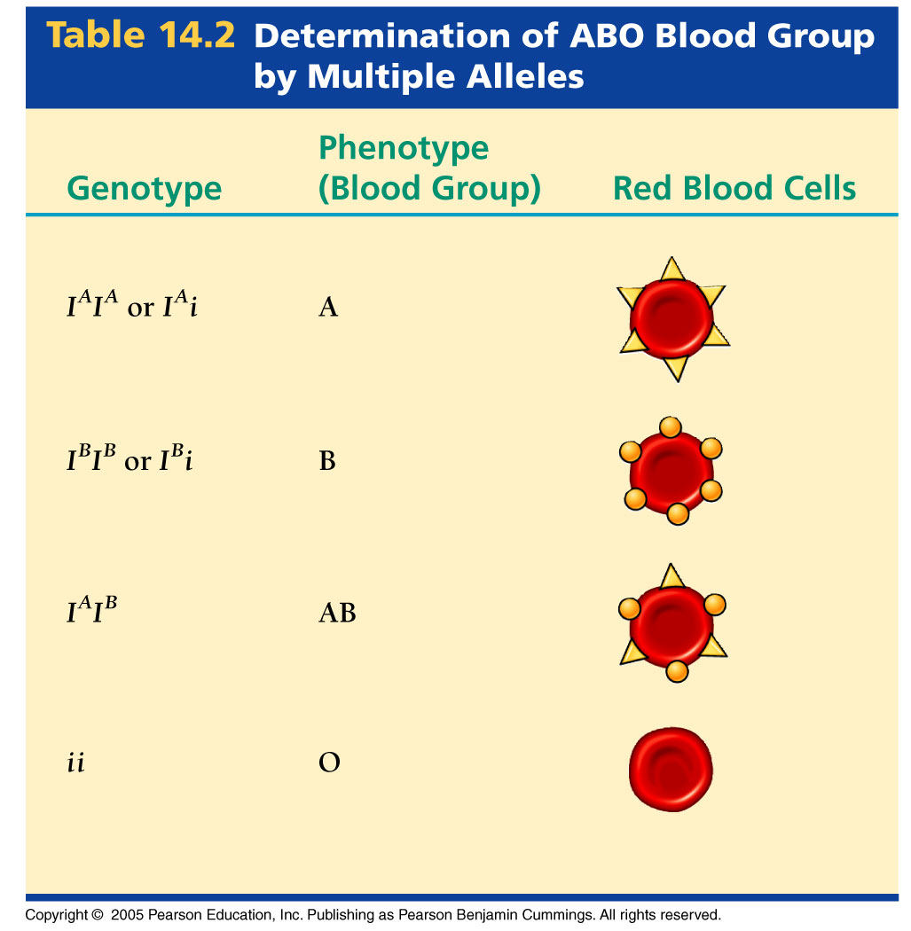
This is also an example of multiple alleles because there are more than two variations on the trait.

Slide 37
Incomplete Dominance
In incomplete dominance, neither allele is dominant, and the hybrid phenotype is a mixture of the two parents.
Example: Geranium color is controlled by a single gene.
RR = Red
WW = White
RW = Pink

Slide 38
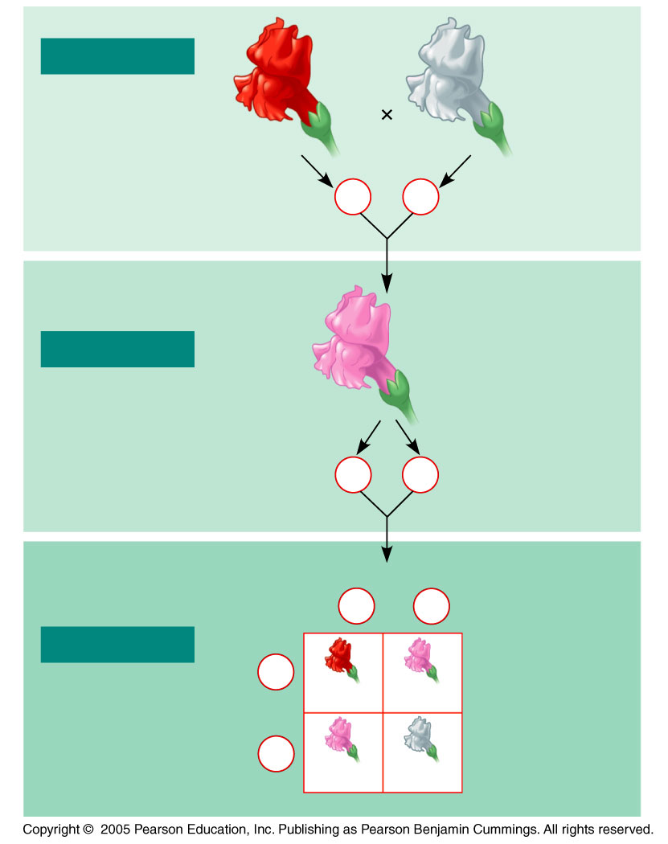
LE 14-10
P Generation
Red
C^{R}C^{R}
White
C^{W}C^{W}
Gametes
C^{R}
C^{W}
F₁ Generation
Pink
C^{R}C^{W}
Gametes
1
2
C^{R}
1
2
C^{W}
1
1
Sperm
2
C^{R}
2
C^{W}
F₂ Generation
Eggs
1
2
C^{R}
C^{R}C^{R}
C^{R}C^{W}
1
2
C^{W}
C^{R}C^{W}
C^{W}C^{W}

Slide 39
Frequency of Dominant Alleles
Dominant alleles are not necessarily more common.
In this example, the recessive allele is far more prevalent than the dominant allele in the population.
For example, one baby out of 400 in the United States is born with extra fingers or toes
The gene that controls this trait is dominant, yet, it is rare.

Slide 40
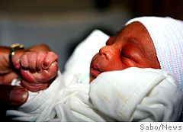
Baby born in Brooklyn with an extra finger; inherited from his father.
Picture from NY Daily News, Aug 29, 2007

Slide 41
Pleiotropy
Most genes have multiple phenotypic effects, a property called pleiotropy
For example, pleiotropic alleles are responsible for the multiple symptoms of certain hereditary diseases, such as cystic fibrosis and sickle-cell disease

Slide 42
Epistasis
In epistasis, a gene at one locus alters the phenotypic expression of a gene at a second locus
For example, in mice and many other mammals, coat color depends on two genes
One gene determines the pigment color
The other gene determines whether the pigment will actually be deposited in the hair

Slide 43
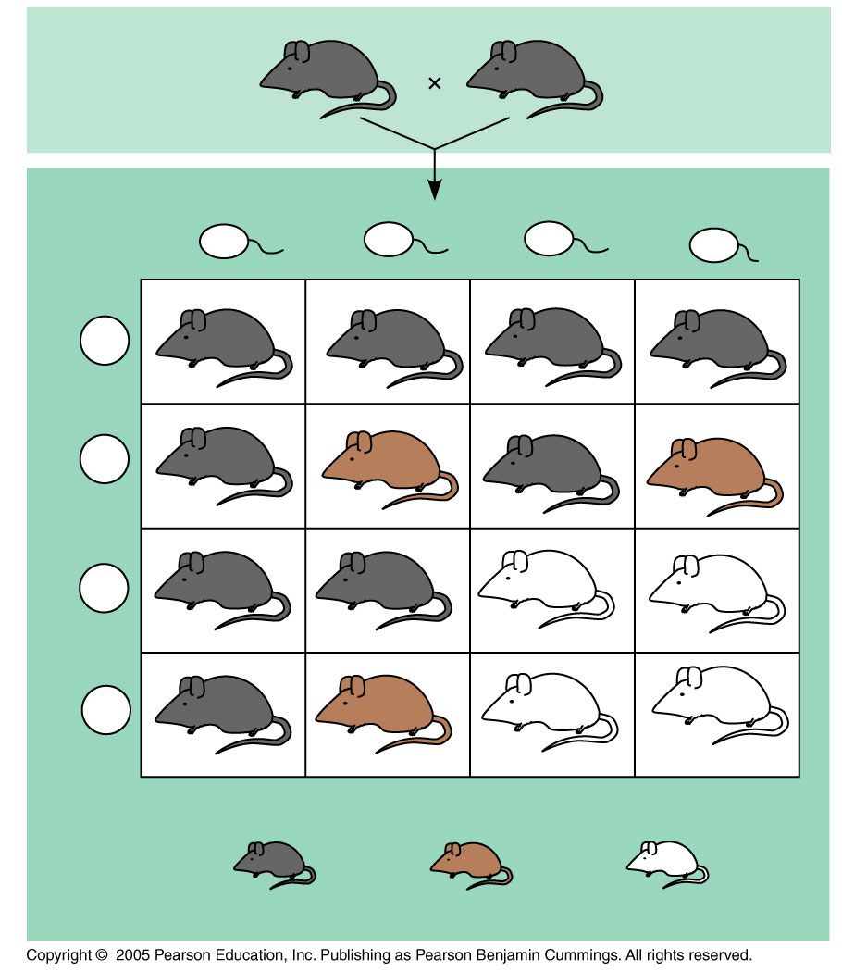
Coat color?
B = Black
b = Brown
BbCc
BbCc
Pigment deposited in hair?
C = Yes, colored fur
c = no, no color
Sperm
1
4
BC
1
4
bC
1
4
Bc
1
4
bc
1
4
BC
BBCC
BbCC
BBCc
BbCc
1
4
bC
BbCC
bbCC
BbCc
bbCc
1
4
Bc
BBCc
BbCc
BBcc
Bbcc
1
4
bc
BbCc
bbCc
Bbcc
bbcc
9
16
3
16
4
16

Slide 44
Polygenic Inheritance
Quantitative characteristics are those that have an entire spectrum of variation.
Examples: Skin color, height
This is caused by polygenic inheritance, when two or more genes affect the same trait.

Slide 45
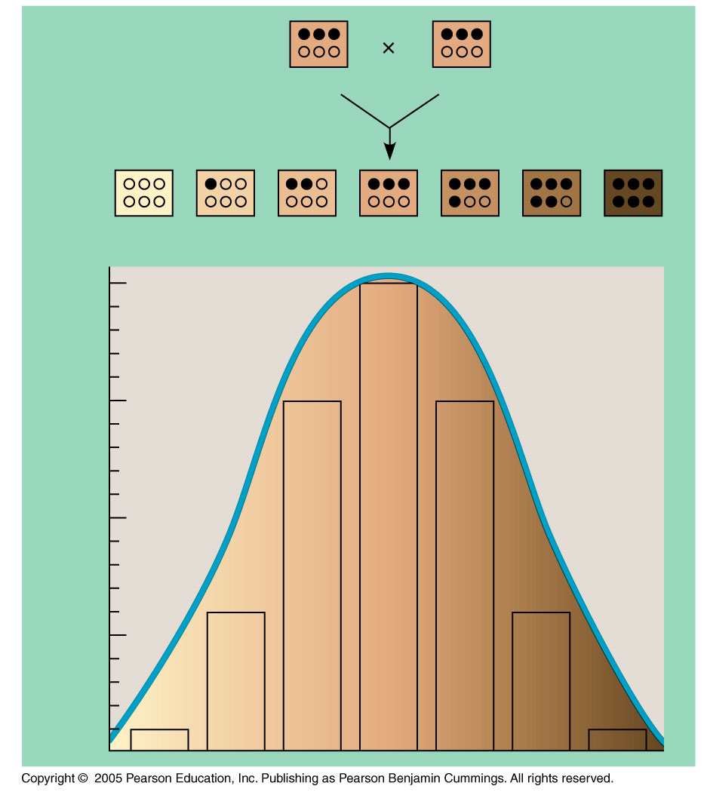
LE 14-12
AaBbCc
AaBbCc
aabbcc
Aabbcc
AaBbcc
AaBbCc
AABbCc
AABBCc
AABBCC
²⁰/64
¹⁵/64
Fraction of progeny
⁶/64
¹/64

Slide 46
Environmental Impacts on Phenotype
Another departure from Mendelian genetics arises when the phenotype for a character depends on environment as well as genotype
For example, hydrangea flowers of the same genotype range from blue-violet to pink, depending on soil acidity

Slide 47
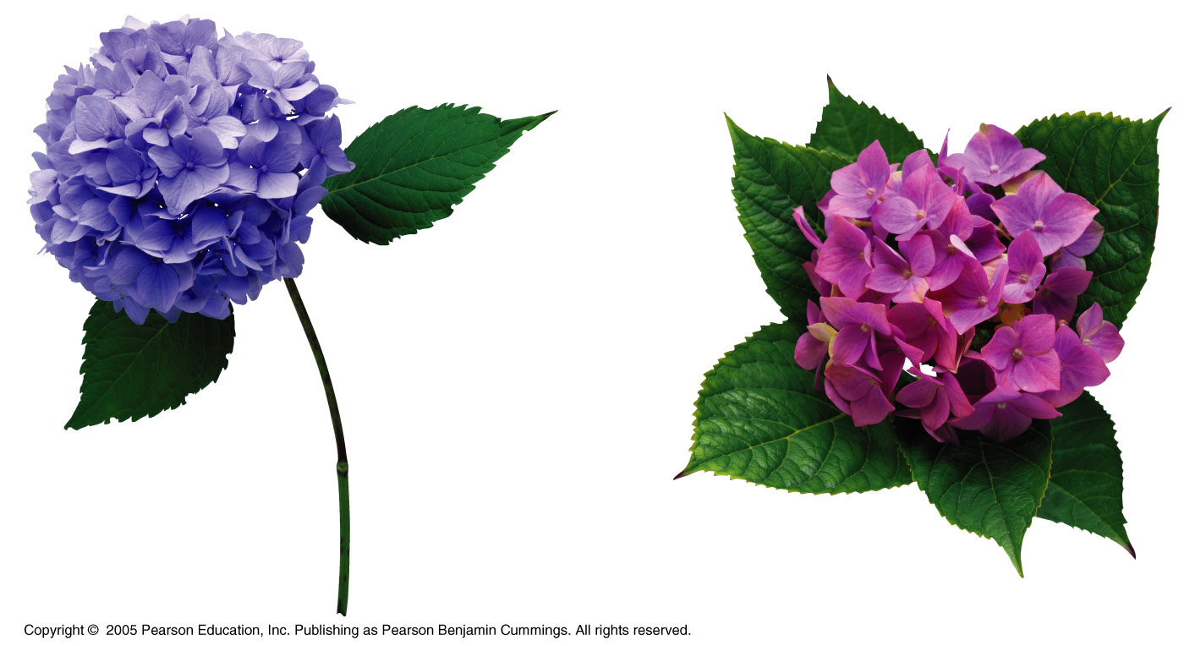

Slide 48
Human Mendelian Traits
Humans are not good subjects for genetic research because generation time is too long; parents produce relatively few offspring; and breeding experiments are unacceptable
However, basic Mendelian genetics endures as the foundation of human genetics

Slide 49
Pedigree Analysis
A pedigree is a family tree that describes the interrelationships of parents and children across generations
Inheritance patterns of particular traits can be traced and described using pedigrees

Slide 50
LE 14-14a
First generation
(grandparents)
Ww
ww
ww
Ww
Second generation
(parents plus aunts
and uncles)
Ww
ww
ww
Ww
Ww
ww
Third
generation
(two sisters)
WW
ww
or
Ww
Widow’s peak
No widow’s peak
Dominant trait (widow’s peak)

Slide 51
LE 14-14b
First generation
(grandparents)
Ff
Ff
ff
Ff
Second generation
(parents plus aunts
and uncles)
FF or Ff
ff
ff
Ff
Ff
ff
Third
generation
(two sisters)
ff
FF
or
Ff
Attached earlobe
Free earlobe
Recessive trait (attached earlobe)

Slide 52
Pedigrees can also be used to make predictions about future offspring
We can use the multiplication and addition rules to predict the probability of specific phenotypes

Slide 53
Recessively Inherited Disorders
Many genetic disorders are inherited in a recessive manner
Recessively inherited disorders show up only in individuals homozygous for the allele
Carriers are heterozygous individuals who carry the recessive allele but are phenotypically normal

Slide 54
Cystic Fibrosis
Cystic fibrosis is the most common lethal genetic disease in the United States, striking one out of every 2,500 people of European descent
The cystic fibrosis allele results in a defective protein transport channel in cell membranes.
Controls transportation of Cl⁻ ions.
Symptoms include mucus buildup in some internal organs and abnormal absorption of nutrients in the small intestine

Slide 55
Sickle-Cell Disease
Sickle-cell disease affects one out of 400 African-Americans.
The gene for Sickle-cell disease is recessive.
A homozygous recessive individual will have a substitution of a single amino acid in the hemoglobin protein in red blood cells.
This causes the red blood cells to be misshapen.
Symptoms include physical weakness, pain, organ damage, and even paralysis

Slide 56
Mating of Close Relatives
Most genetic defects and disorders are caused by recessive genes.
The likeliness of a child inheriting one of these disorders increases when inbreeding occurs.

